Slide 1


Positive and Negative Testing

Slide 2
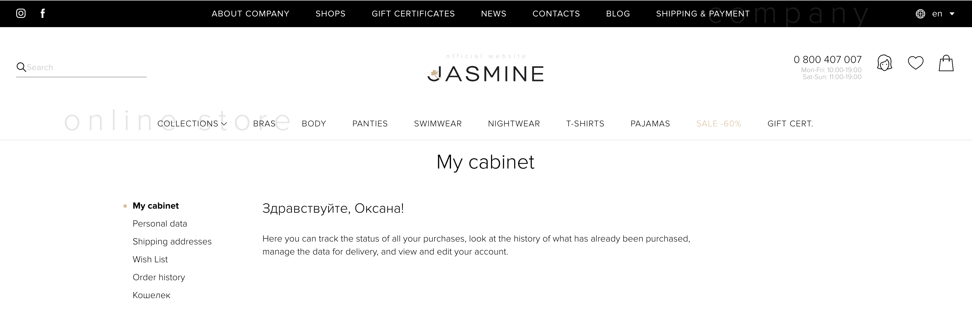
Type the correct email and password. The user is logged in.

Slide 3
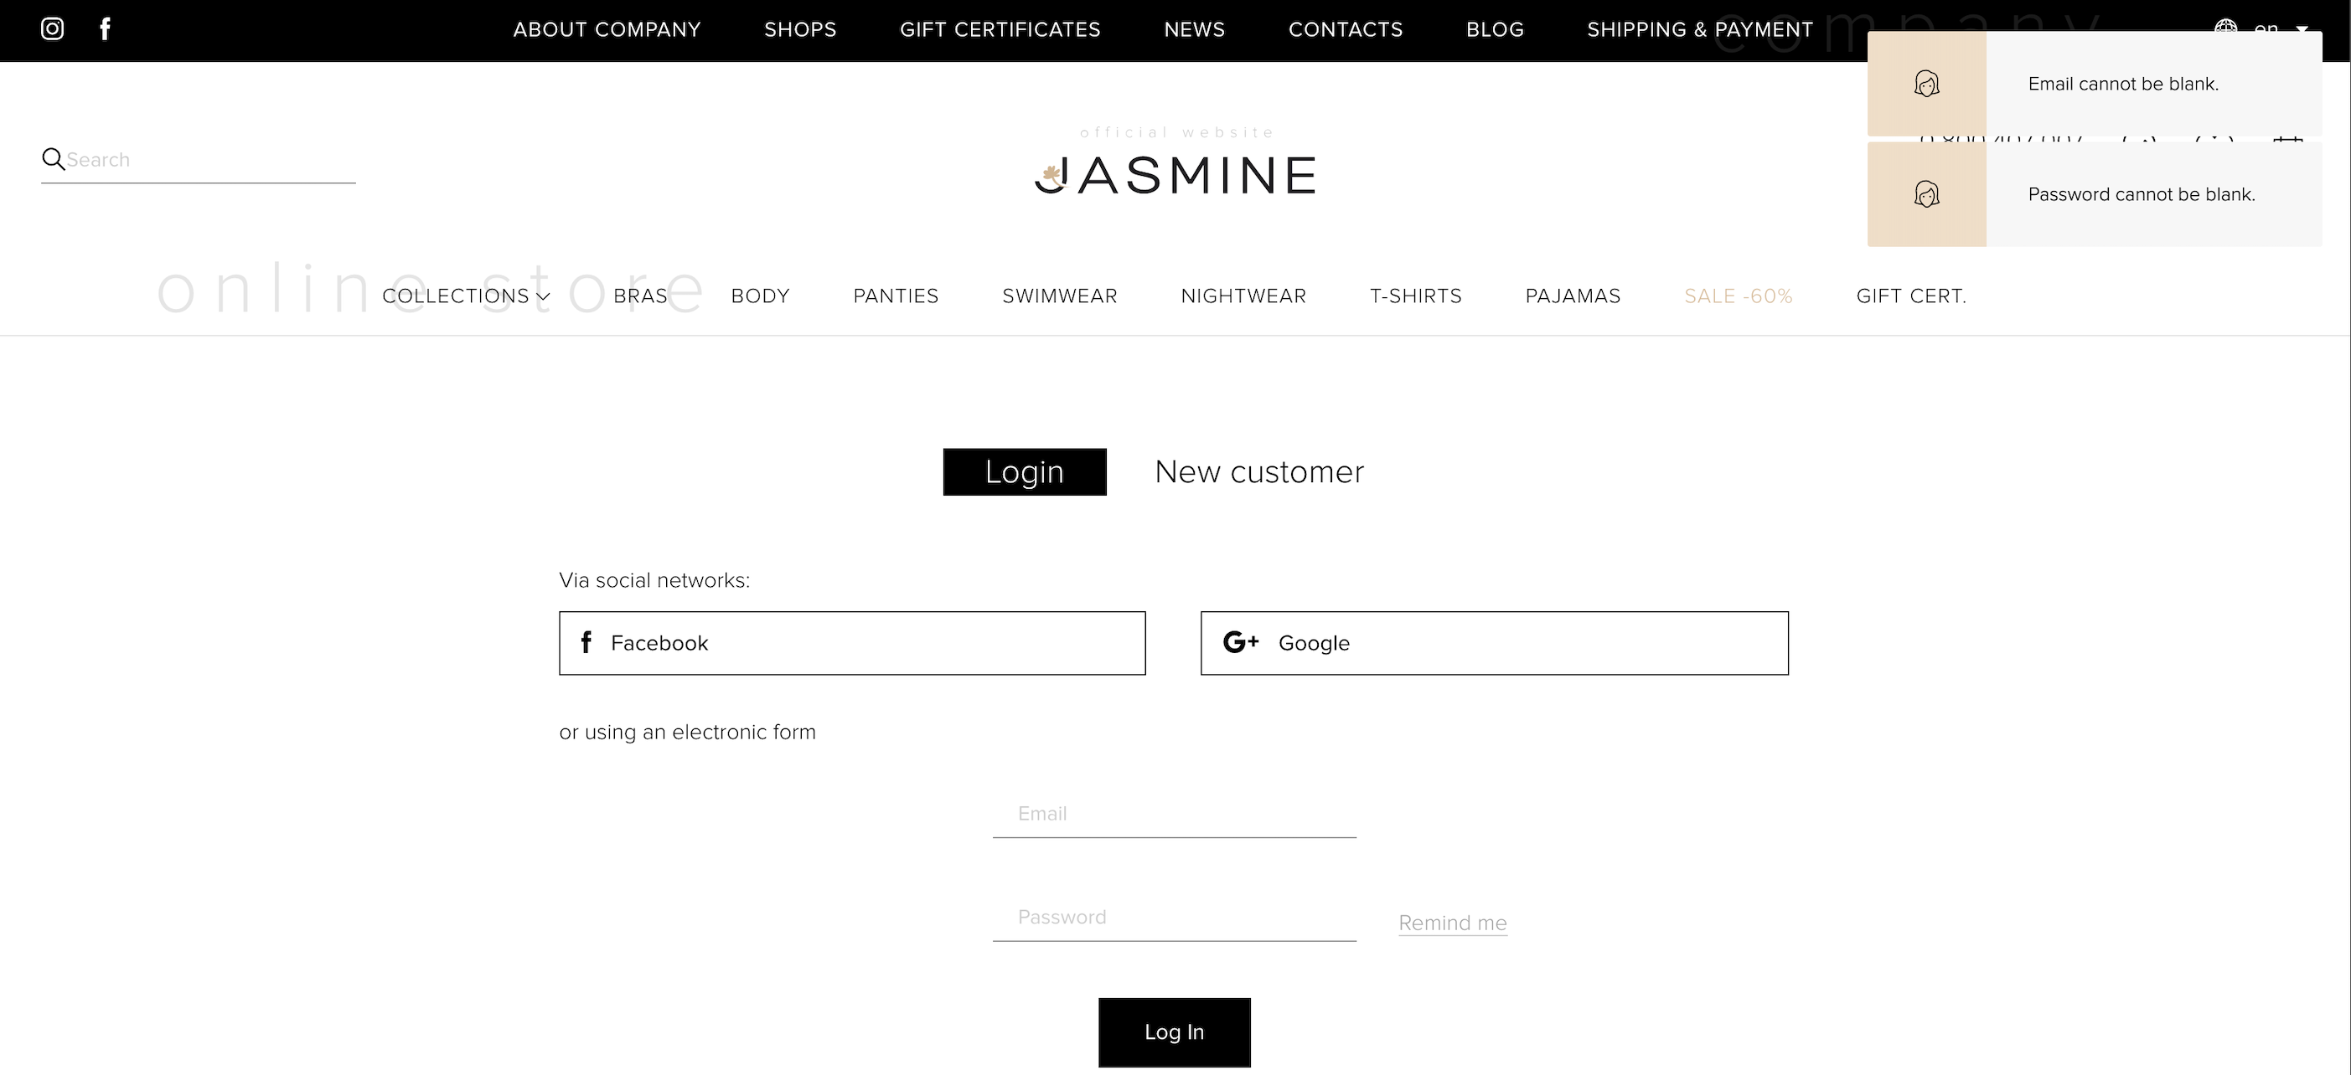
Leave two fields empty. The error message appeared.

Slide 4
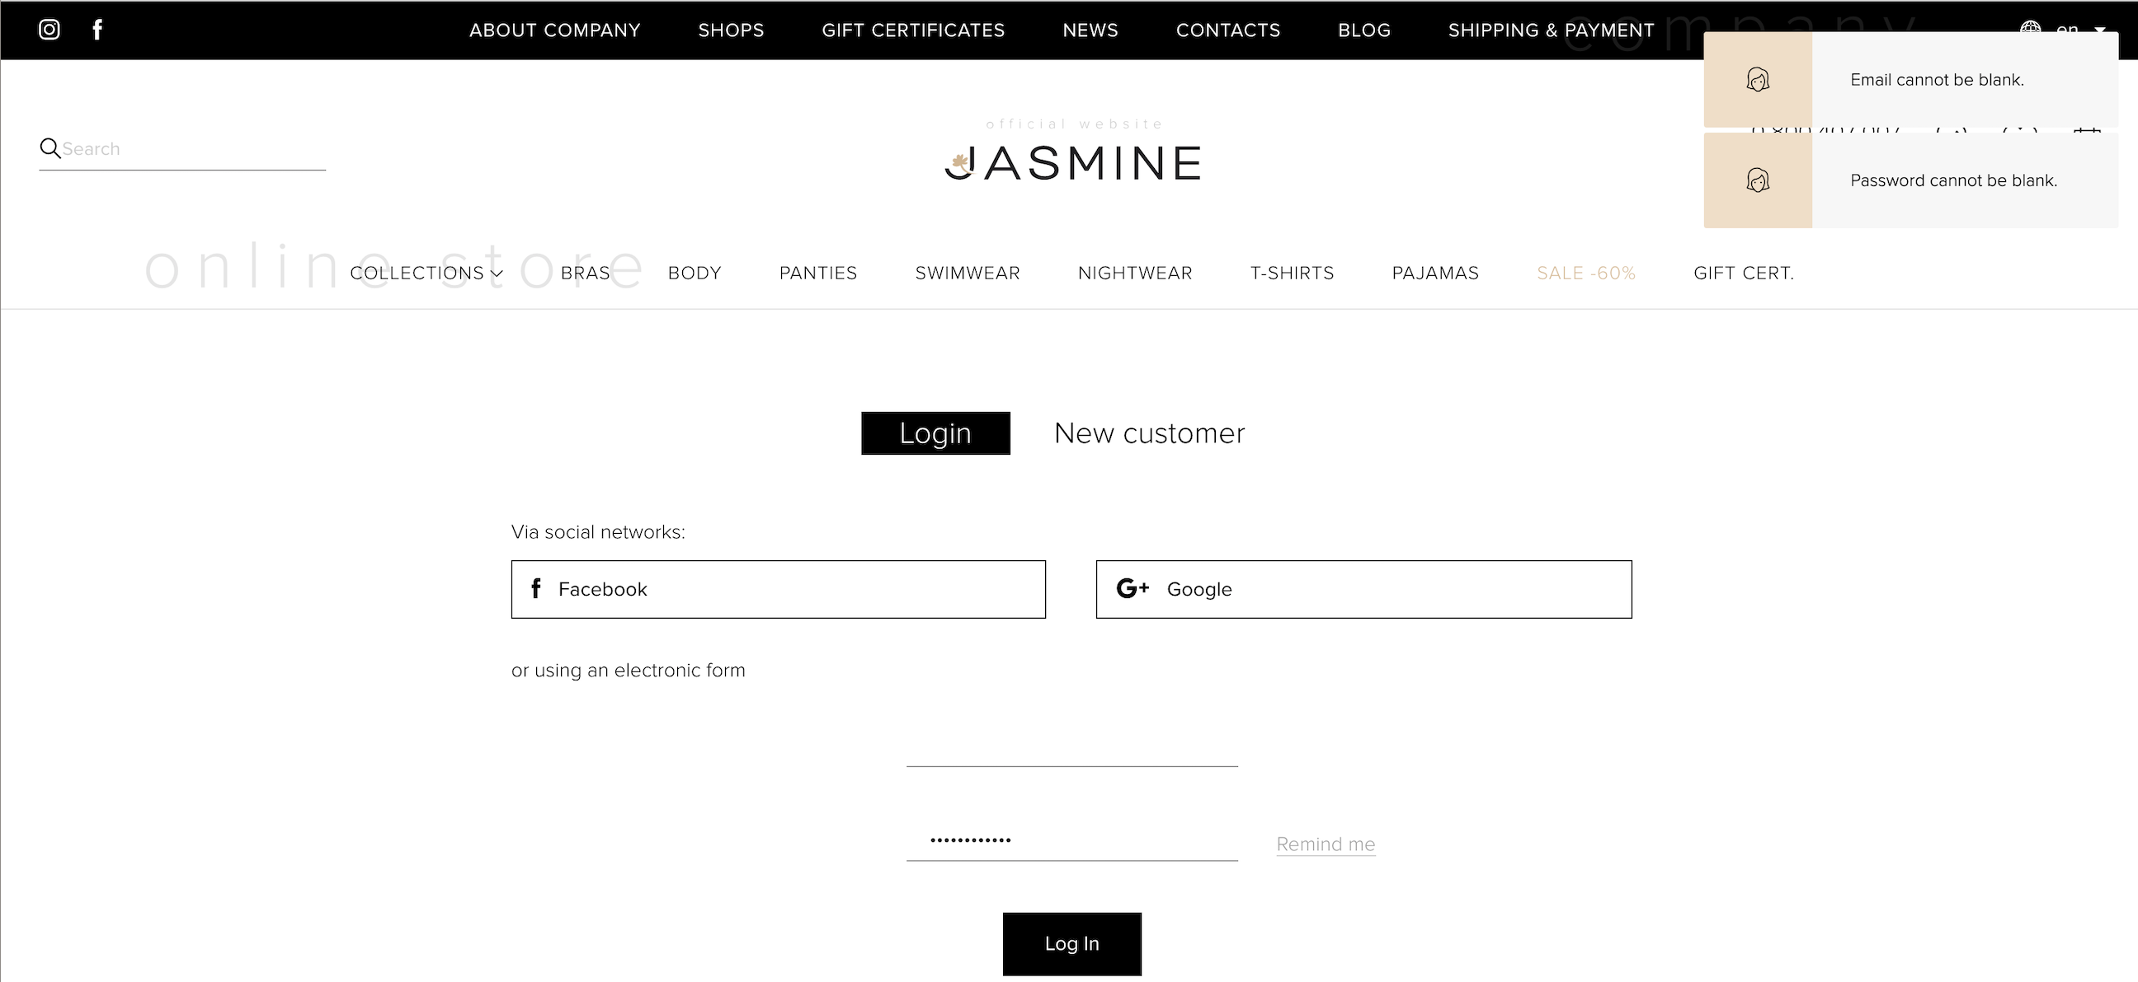
Type the incorrect email and password (only blank) The error message appeared.

Slide 5
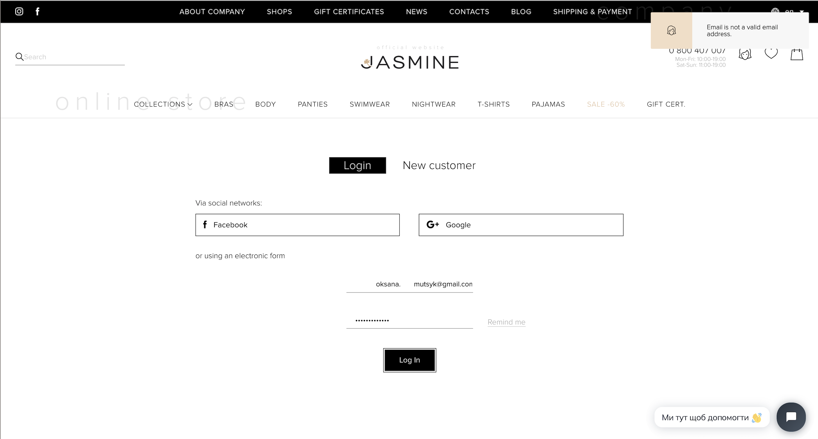
Type the incorrect email( oksana. mutsyk@gmail.com) and the correct password. The error message appeared.

Slide 6
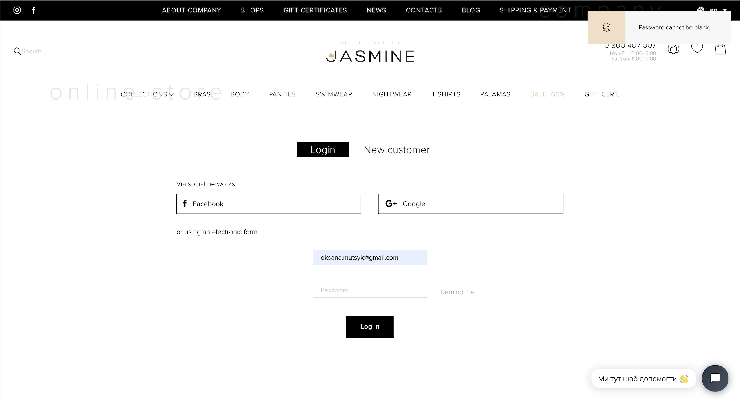
Type the correct email. Leave the password field empty. The error message appeared.

Slide 7
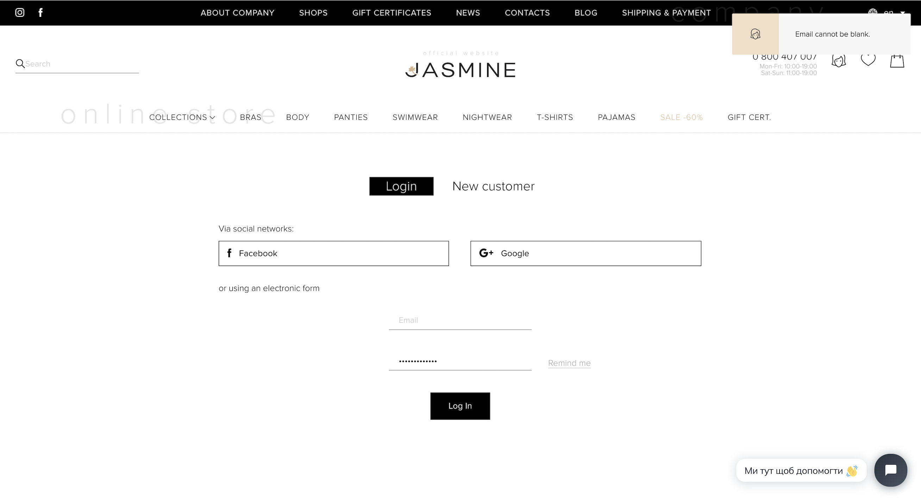
Type the correct password. Leave the email field empty. The error message appeared.

Slide 8
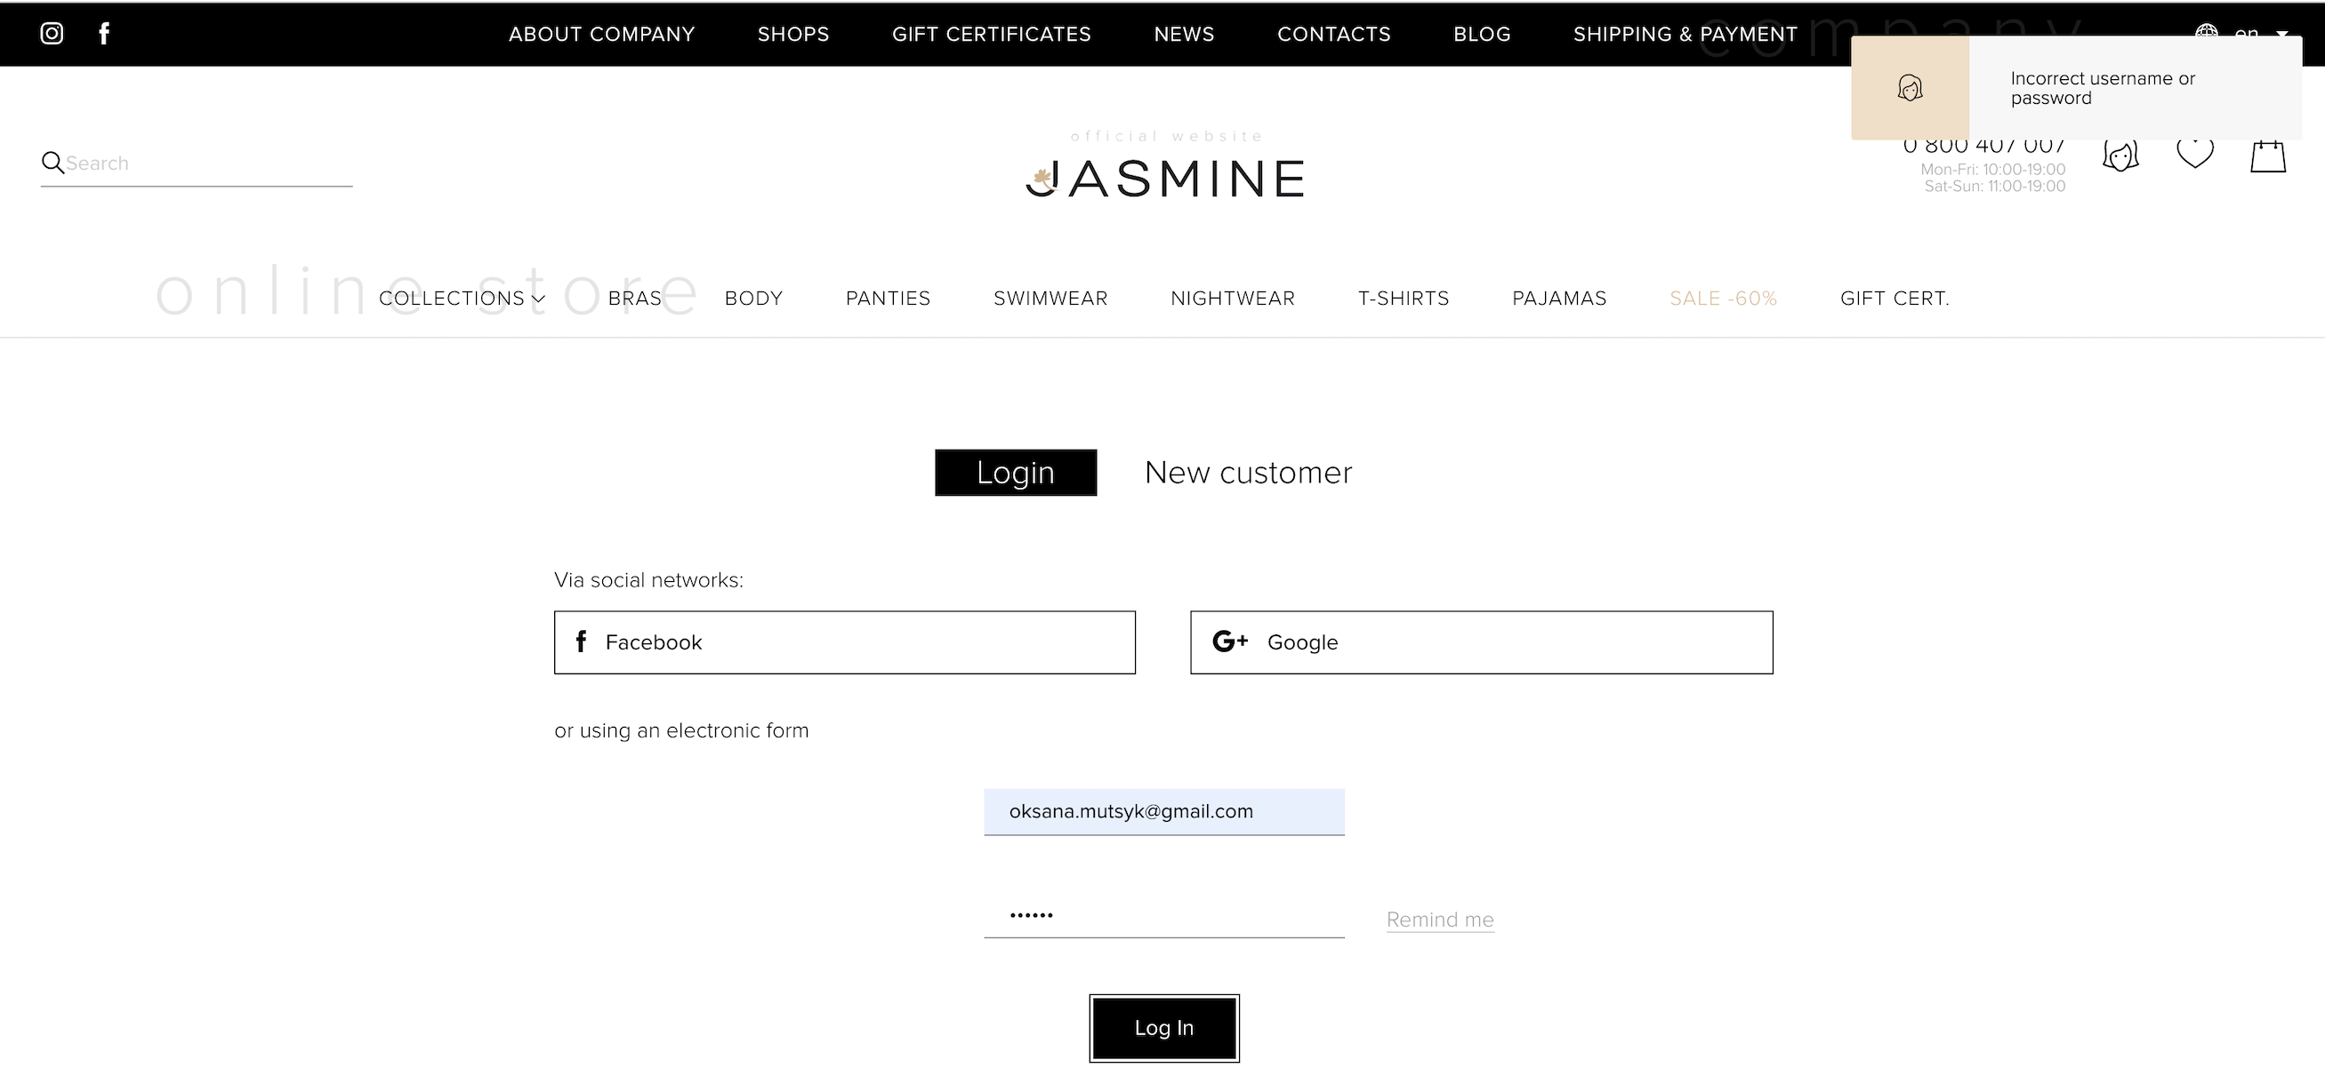
Type the incorrect password (123456) and the correct email. The error message appeared.

Slide 9
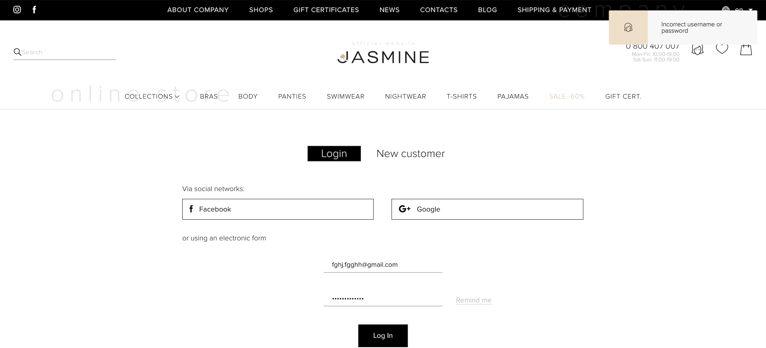
Type the incorrect email(fghj.fgghh@gmail.com) and the correct password. The error message appeared.

Slide 10
Type the incorrect email and the incorrect password. The error message appeared.

Slide 11
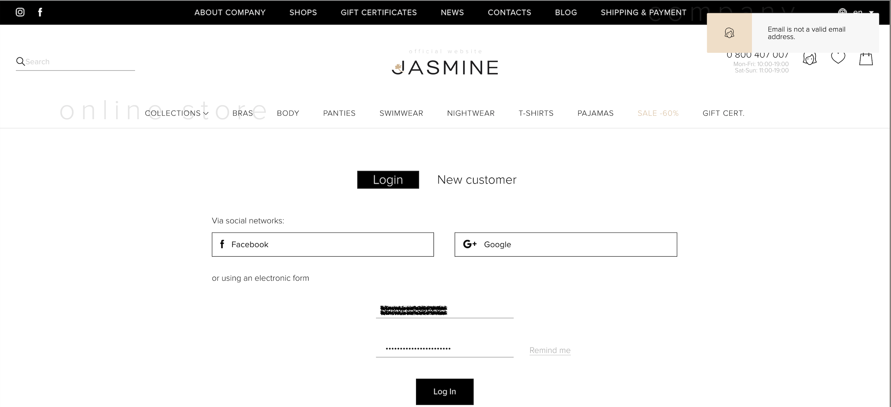
Type the incorrect email(your password) and the incorrect password(your email). The error message appeared.

Slide 12

Type the incorrect email(<script>alert(123)</script>) and the correct password. The error message appeared.

Slide 13
Type the incorrect email(DROP TABLE user;) and the correct password. It’s my favorite website :)

Slide 14
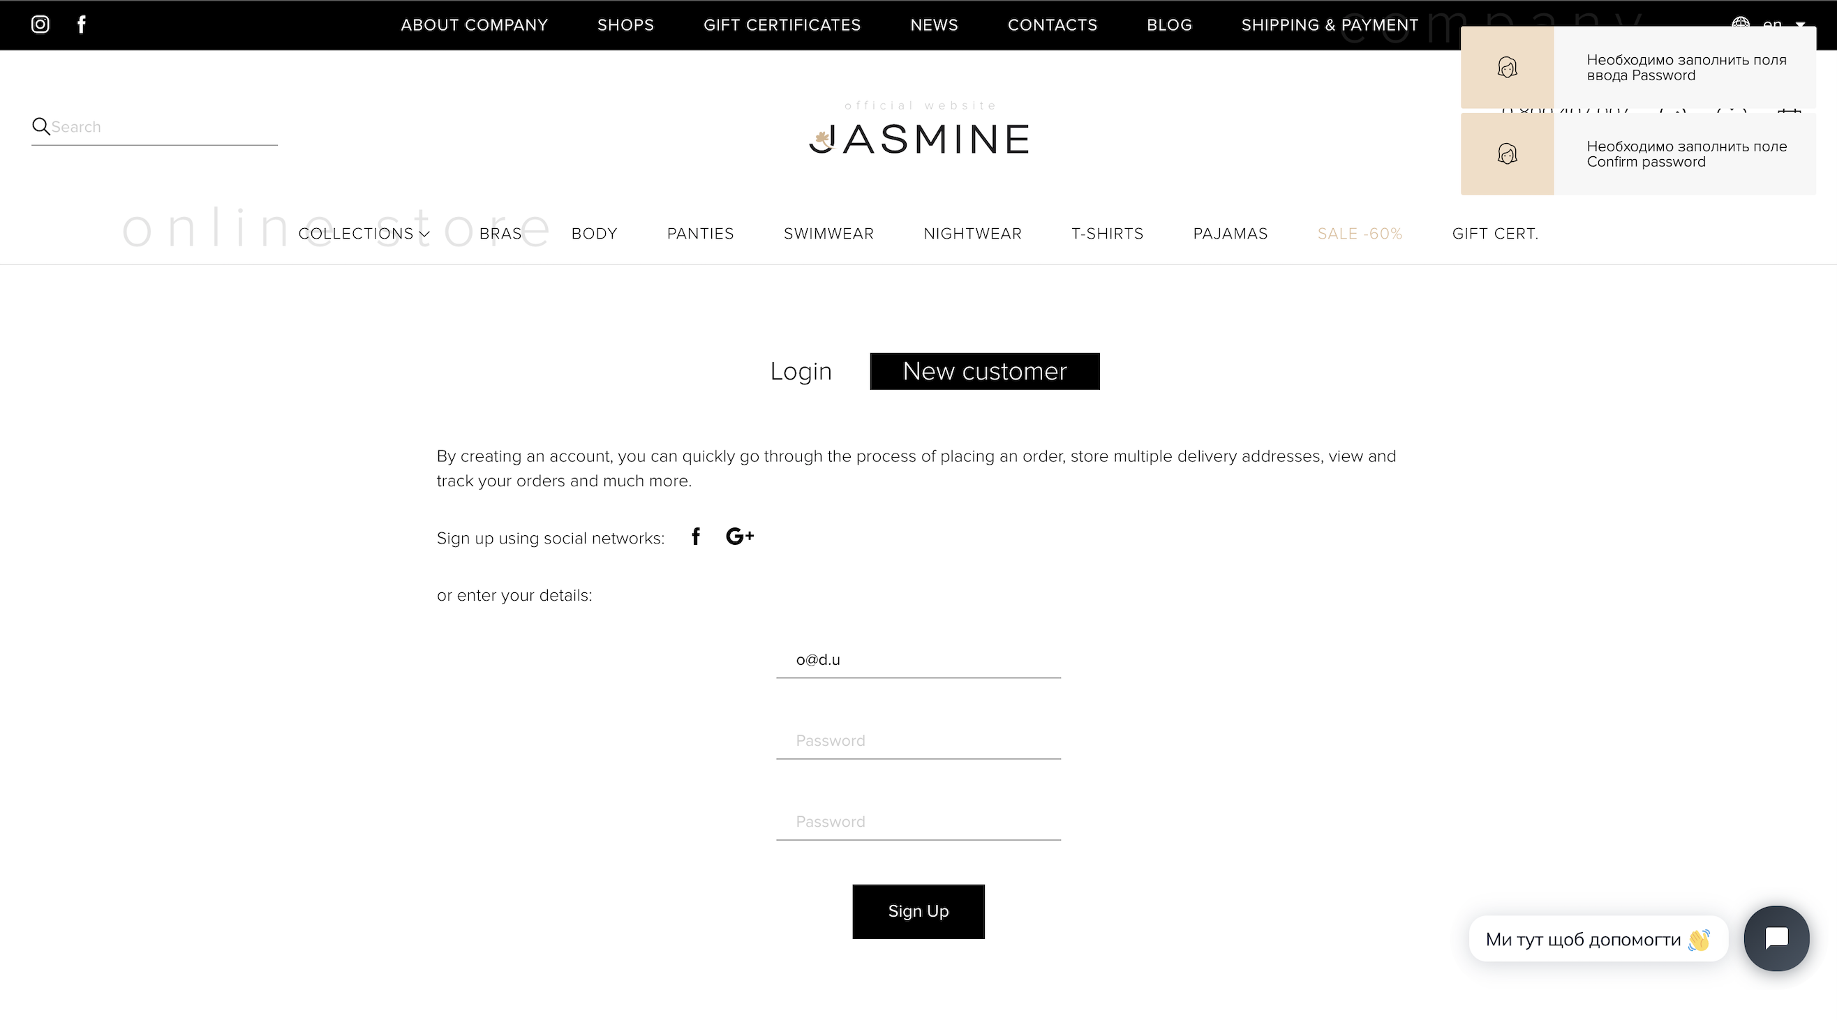
Login new user with email (5 characters with "." and "@") o@d.u Defect: The message isn't translated into English.

Slide 15
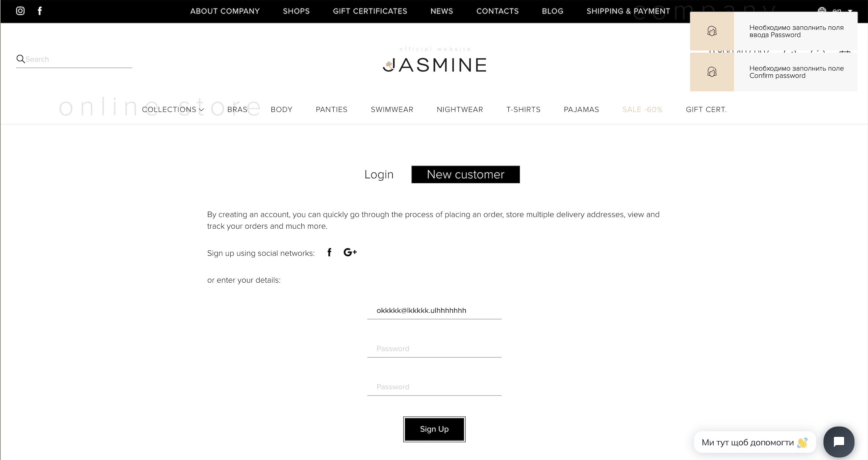
Login new user with email (> 6 and < 256 characters with "." and "@") okkkkk@lkkkkk.ulhhhhhhh Defect: The message isn't translated into English.

Slide 16
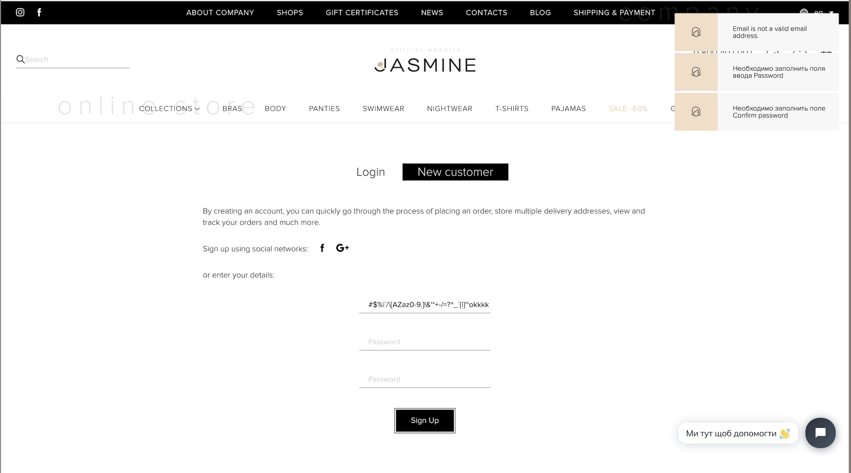
Login new user with email (> 6 and < 256 characters with "." and "@") The email has to contain specific symbols ( # $ % | ` / \ [AZ az 0-9. ]! # $% & '* + - / =? ^ _ `{|} ~) #$%|`/\[AZaz0-9.]!&'*+-/=?^_`{|}~okkkkk@lkkkkk.ulhhhhhhh The error message appeared. Defect: The message isn't translated into English.

Slide 17
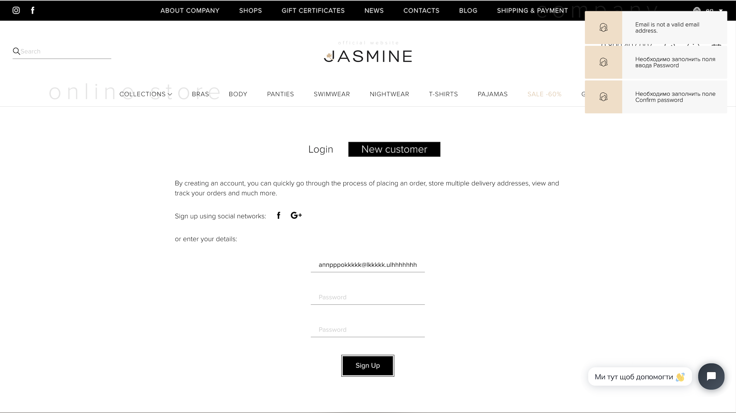
Login new user with email (> 6 and < 256 characters with "." and "@") The email has to contain Cyrillic characters. аппрррokkkkk@lkkkkk.ulhhhhhhh The error message appeared. Defect: The message isn't translated into English.

Slide 18
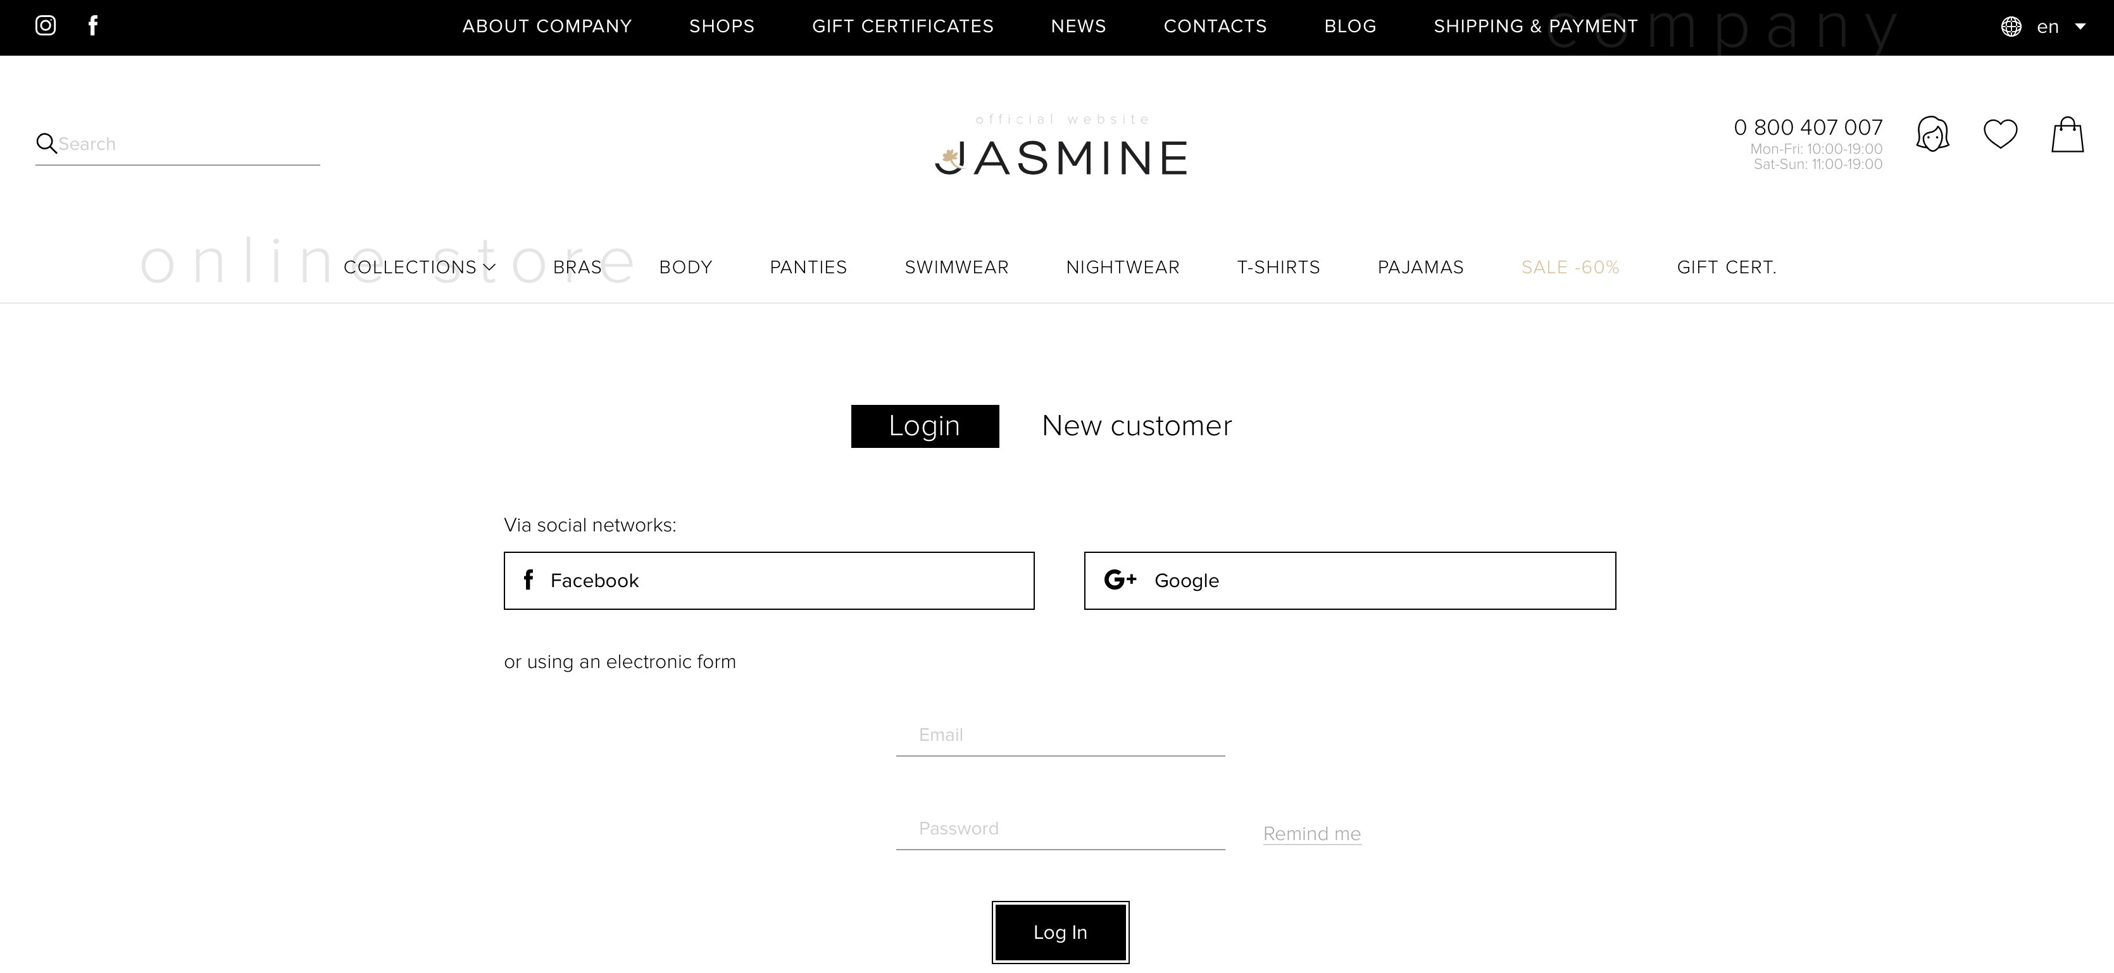
Login and copy the URL then paste it in another browser. It should not display the user’s welcome page.

Slide 19
Login, and change your password. Logout, and try to enter with the previous password. The error message appeared.

Slide 20
Login with a new password. The user is logged in with a new password.

Slide 21



